Slide 1
Week 30
GNN relative works

Slide 2
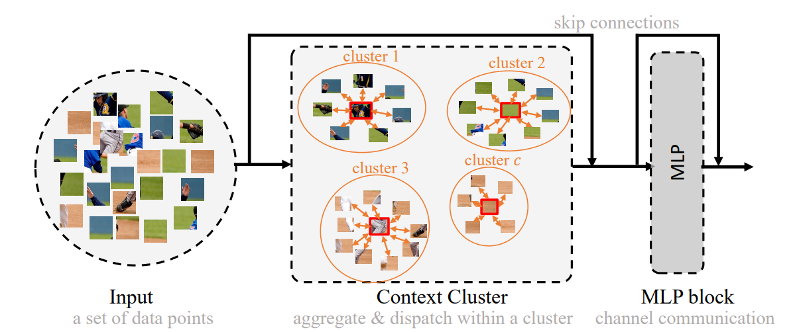

Image as set of points

Slide 3
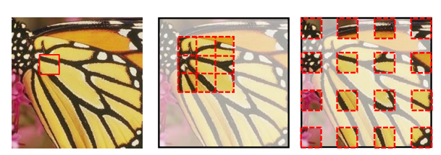


Image Processing GNN: Breaking Rigidity in Super-Resolution

Slide 4
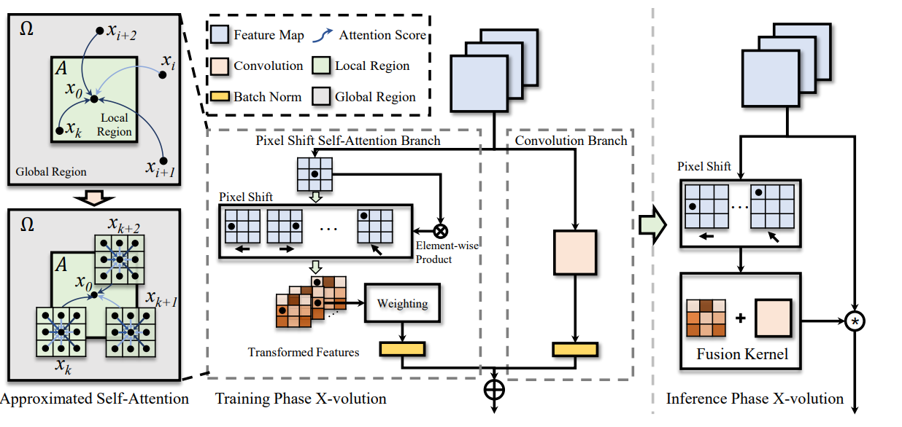
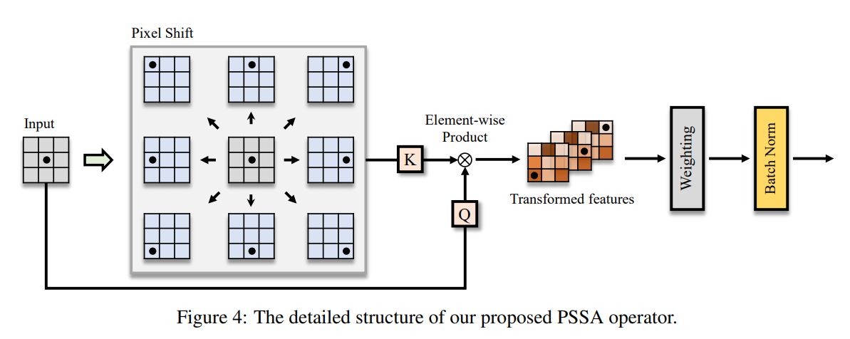
X-volution: On the Unification of Convolution and Self-attention

Slide 5
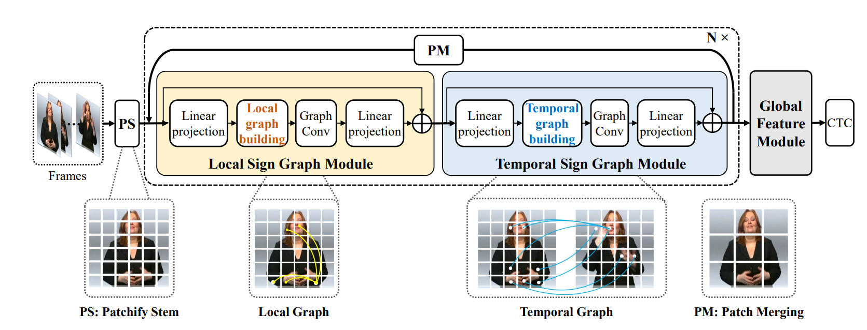
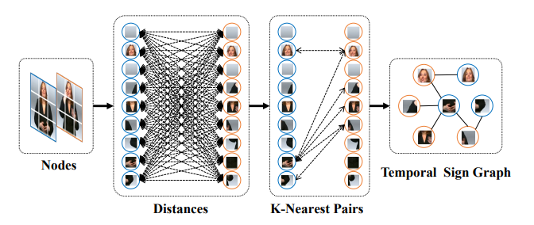
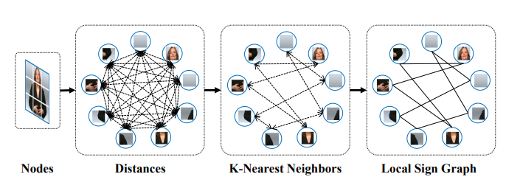
SignGraph: A Sign Sequence is Worth Graphs of Nodes

Slide 6
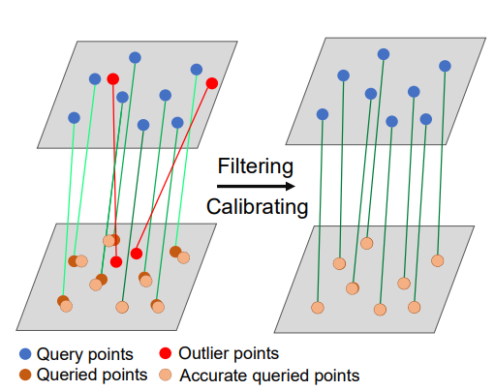
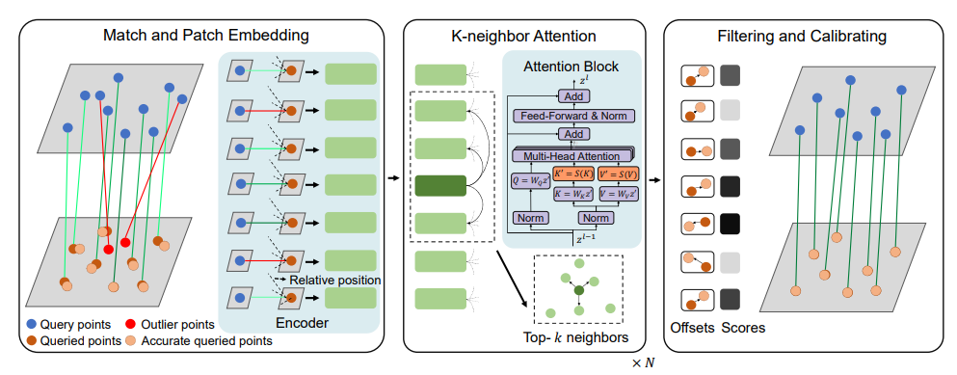
FC-GNN: Recovering Reliable and Accurate Correspondences from Interferences

